Slide 1
MVP Scoping

Slide 2
Agenda
What is an MVP
How to define the MVP scope
Benefits of MVP scoping
Steps Involved in MVP scoping
Case Studies

Slide 3
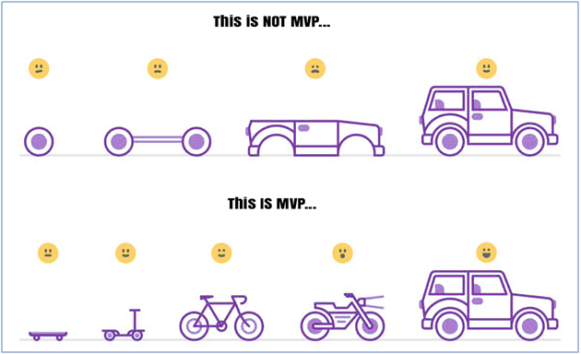
What is an MVP

Slide 4


What is an MVP
A minimum viable product (MVP) is a product with the minimum features necessary to be released to customers and gather feedback.
The goal of an MVP is to learn as quickly as possible whether your product is meeting the needs of your target customers.
An MVP is not a finished product. It is a way to get your product in front of customers and start learning from them early in the development process.

Slide 5
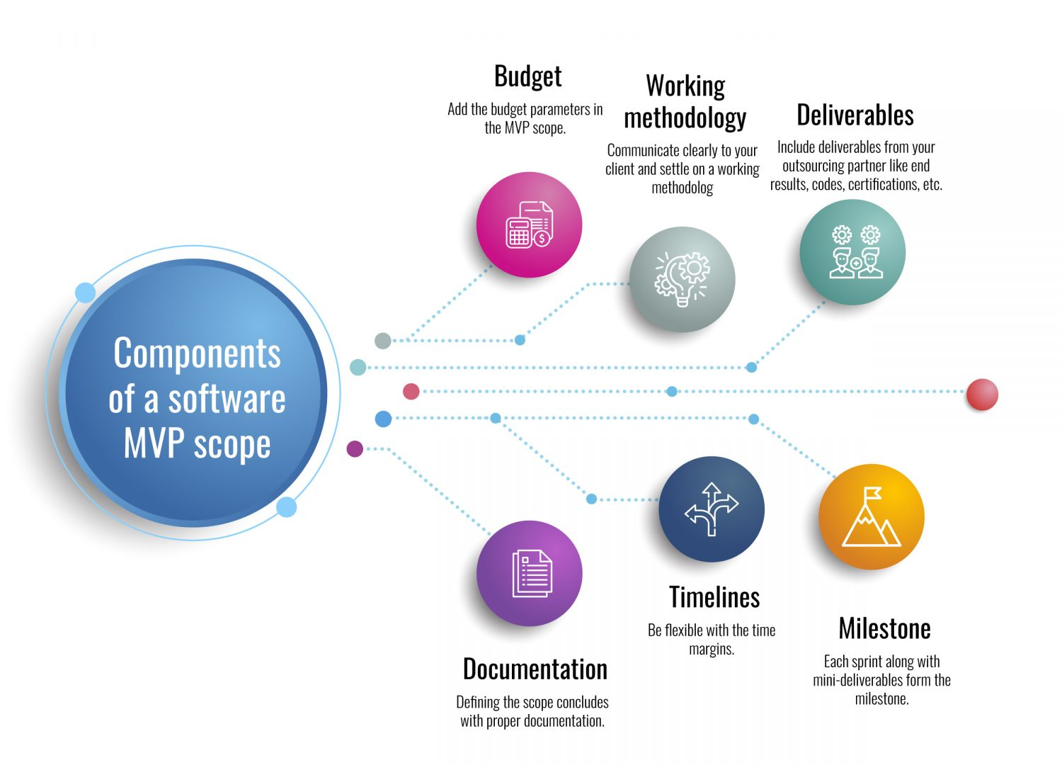
How to define the MVP scope
Start by understanding your target customers and their needs.
Identify the core features that are essential to meeting those needs.
Prioritize the features that you will include in your MVP.
Be clear about what features you will not include in your MVP.

Slide 6
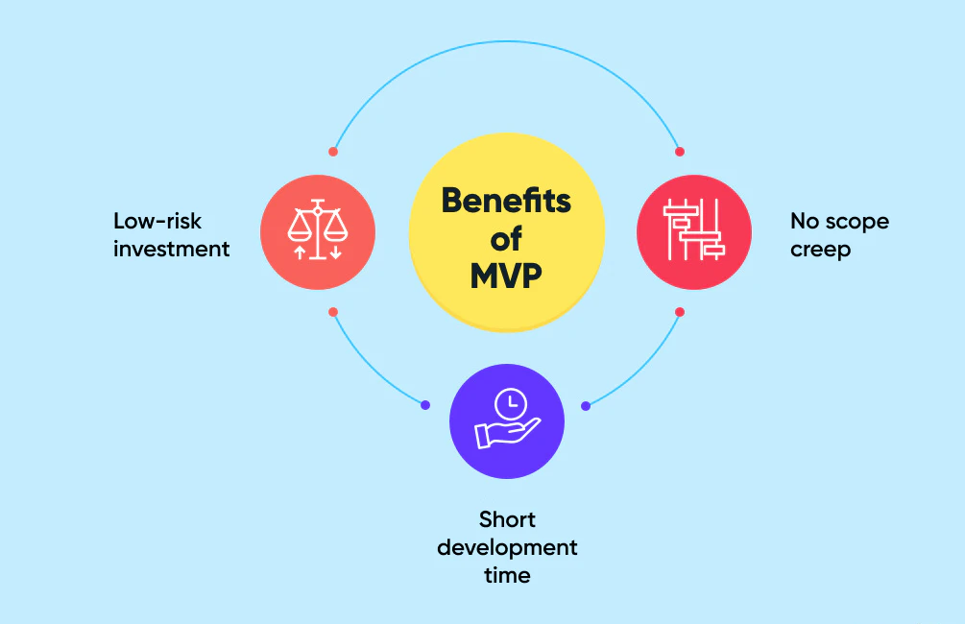
Benefits of MVP scoping
Save time and money
Reduce risk
Improve your chances of success
Prevent scope creep
Get your product to market faster

Slide 7
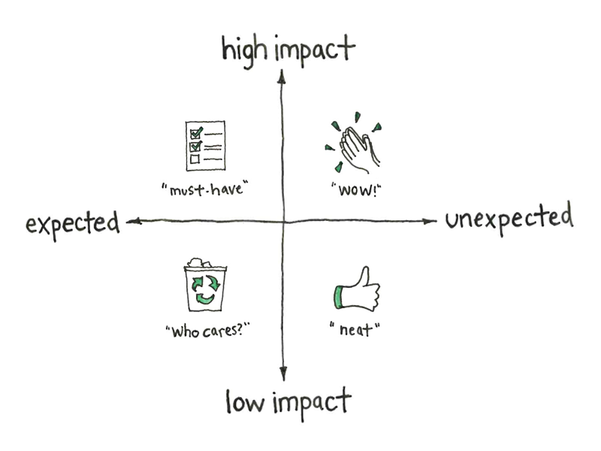
Steps involved in MVP scoping
Define your goals. What do you want to achieve with your MVP?
Understand your target customers. Who are your target customers? What are their needs?
Identify the core features. What are the core features that your MVP must have?
Prioritize the features. Which features are the most important?

Slide 8
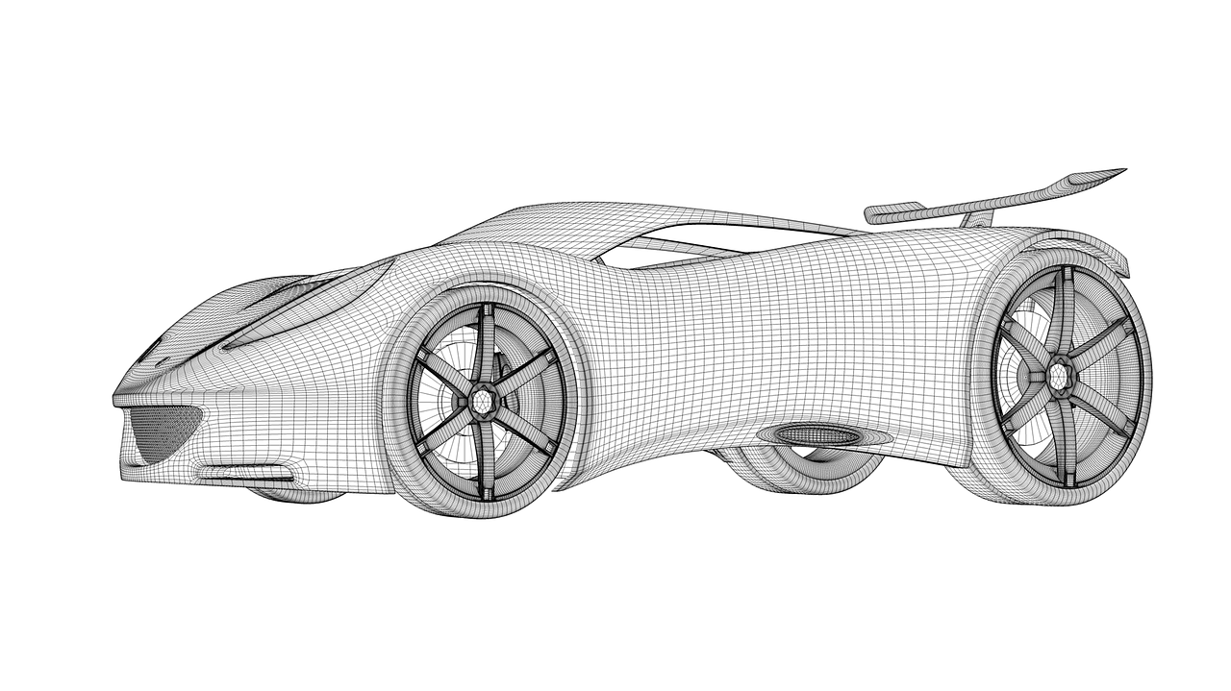
Steps involved in MVP scoping
Define the non-features. What features will you not include in your MVP?
Create a prototype. Build a prototype of your MVP to test with your target customers.
Get feedback. Gather feedback from your target customers and use it to iterate on your MVP.

Slide 9
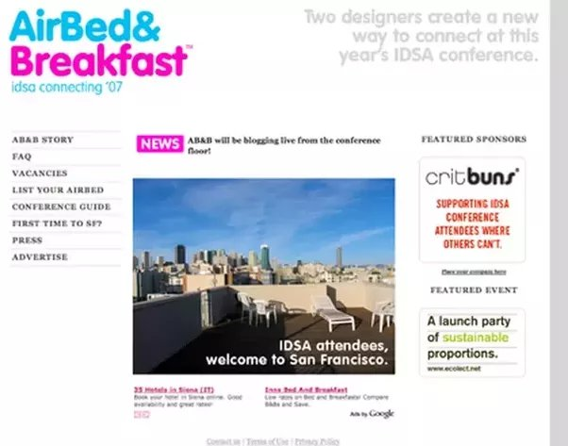
Case Study 1
Airbnb:
Airbnb's MVP was a simple website that allowed people to list their homes for rent. The MVP was successful because it met the needs of Airbnb's target customers, who were looking for a way to rent out their homes when they were not using them.

Slide 10
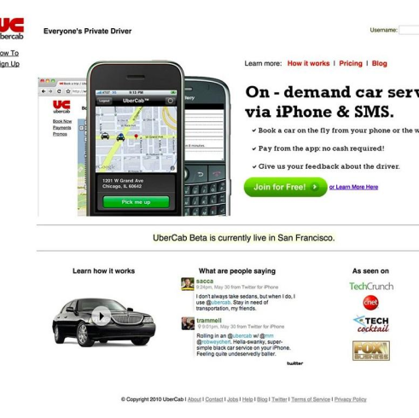
Case Study 2
Uber:
Uber's MVP was a mobile app that allowed people to request rides from drivers. The MVP was successful because it met the needs of Uber's target customers, who were looking for a convenient way to get around town.

Slide 11
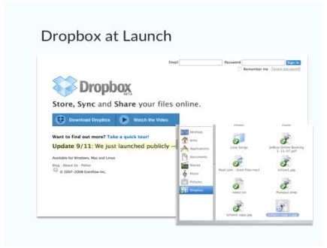
Case Study 3
Dropbox:
Dropbox's MVP was a file-sharing service that allowed people to store files in the cloud. The MVP was successful because it met the needs of Dropbox's target customers, who were looking for a way to share files with others and access them from anywhere.

Slide 12
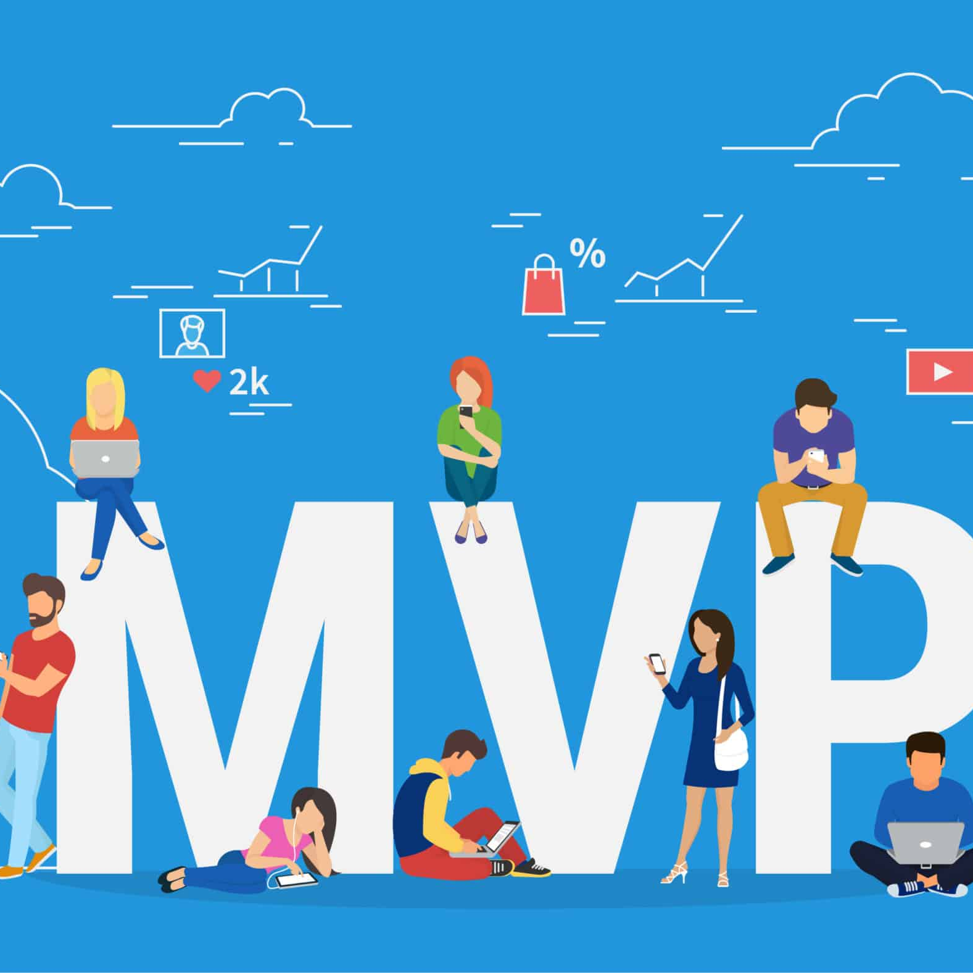
Interesting links
https://www.enlume.com/mvp-helped-four-unicorns-uber-airbnb-dropbox-zappos/
https://blog.appsumo.com/5-greatest-minimum-viable-products/

Slide 13
Thank you

